Slide 1
Introduction to Drug Discovery

Slide 2
Introduction to Drug Discovery Informatics
Drug can be defined as a substance intended for use in the diagnosis, cure,mitigation, treatment or prevention of disease or as a component of a medicine.
Drug discovery is the process of discovering and design the drugs.This process is very important, involving analyzing the causes of diseases and finding ways to tackle them.
This process is so long and expensive that it might cost millions of dollars and take a dozen years
Accuracy of identification of target is not good enough which in turn delays the process.

Slide 3
Continue..
Bioinformatics is generally defined as the research, development and application of computational tools and approaches for expanding the use of biological, medical and health data including those to acquire, store, organize, archive, analyze and visualize such data.
It can explore the causes of diseases at the molecular level, explain the phenomena of diseases from the angle of the gene and make use of computer techniques and enhance the accuracy of results so as to reduce the cost and time.

Slide 4
History
The discovery of drugs historically has been serendipitous(Ratti and Trist 2001).
For most of its history drug discovery has been a product of trial and error.
Long before the pharmaceutical industry existed, drug were discovered by accident and their uses passed down by verbal and written records.
According to Boa(2003) “”Throughout history people have found by trial and error which berries,roots and barks could be used for medicinal purposes to alleviate symptoms of illness . For Example the Willow bark, which contains Salicin was used as a fever reducer.

Slide 5
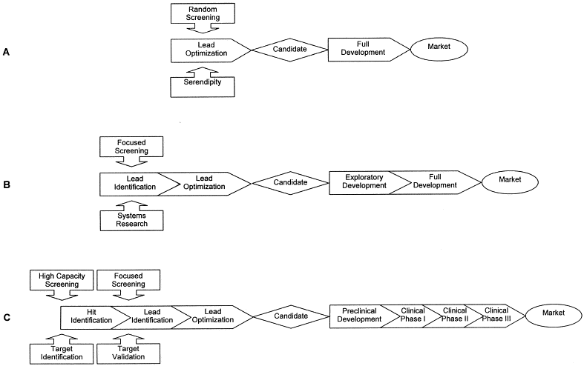

Slide 6
Continue…
Figure Shows evolution of the drug discovery process during the second half of the 20th century. The process is centered on the crucial decision point that leads to the selection of a candidate for full development. The process used in the 1950s and 1960s (panel A), mainly driven by limited random screening and serendipity, was lengthened considerably during the 1980s (panel B) to allow for a more rational approach to structure–activity relationship studies and for improved safety of the molecules. Today’s process (panel C) has been enriched by advances in technological developments in screening, synthetic chemistry, and by the increased number of possible targets due to the application of genomics and bioinformatics

Slide 7
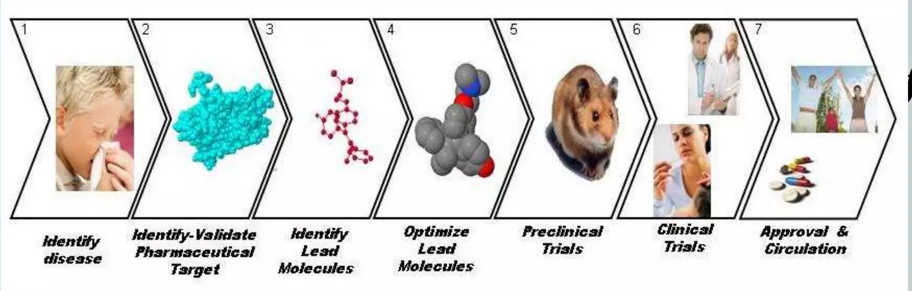
Modern Drug Discovery

Slide 8
Bioinformatics in Drug Discovery
Bioinformatics is booming Subject combining biology with computer science. It can explore the causes of diseases at the molecular level, explain the phenomena of diseases from the angle of the gene and make use of computer techniques and enhance the accuracy of results so as to reduce the cost and time.
In recent years we have seen an explosion in the amount of biological information that is available.It appears that the ability to generate vast quantity of data has surpassed the ability to use this data meaningfully.
All marketed drugs today target only about 500 gene products. The elucidation of the human genome which has an estimated 30,000 to 40,000 genes presents immense new opportunities for drug discovery and simultaneously creates a potential bottleneck regarding the choice of targets to support the drug discovery pipeline.

Slide 9
Drug Discovery Based on Bioinformatics Tools.
The process of designing a new drug using bioinformatics tools have open a new area of research . In order to design a new drug one need to follow the following path
Identifying Target Disease
Study Interesting Component
Detect the molecular basis For Disease
Refined the component
Qualitative Structure Activity Relationships.
Solubility of Molecule
Drug Testing

Slide 10
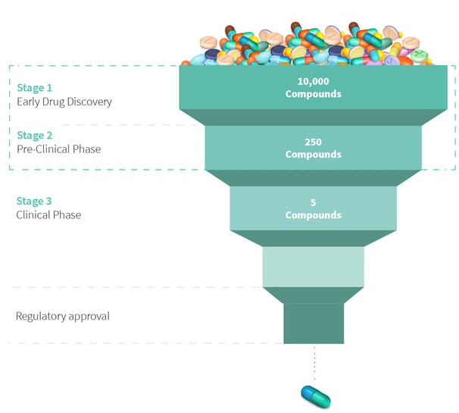
Basic Four Stages of Drug Discovery

Slide 11
Drug Discovery Stages
Early Drug Discovery
Researchers Collaborate to identify and optimize potential leads to specific Targets.
Essentially the leads must elicit a desirable effect on a specific biological target implicated in a disease., in the hopes of treating it.
2. Preclinical Phase

Slide 12
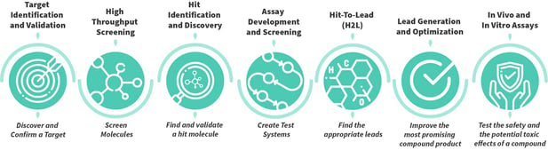
Continue…

Slide 13
Preclinical Phase
The substance identified during early drug discovery are refined, optimized, and extensively tested in laboratory and in Animal or Alternative Models.
The aim is to provide sufficient evidence of safety and efficacy before clinical phase.
In Vivo and In Vitro Methods.
In Vivo :- In vivo is Latin for “within the living.” It refers to studies that are done within living organisms. For example, studies performed on cattle.
In Vitro :- In vitro is Latin for “within the glass.” A study performed in vitro is done outside a living organism. For example, in a test tube or lab.

Slide 14



Clinical Phase
Before the Clinical Trials start it must be ensured that the new substance is available in sufficient quantities during the clinical studies.
Clinical Trials are composed of four phases: Phase I, II, III, and IV.
Phase I :
In the first stage, the tolerance and safety of the drug candidate will be tested in a very small group of healthy subjects
Phase I aims to answer the following questions.

Slide 15
Clinical Phase II…
After tolerance and effectiveness have been tested in a small group, phases IIa, and IIb are started to examine the effectiveness, tolerability, and dosage in a larger group.
In Phase II clinical studies, the effect is tested on people suffering from a specific disease. Up to 500 patients will take part in the Phase II studies.
In this phase, not only the effectiveness and tolerability of the drug should be checked, but also the appropriate dosage should be determined.

Slide 16
Clinical Phase III
If the drug has successfully passed Phase II, it will be further investigated in a larger number of patients in Phase III clinical studies.
The aim is to show that the drug offers the desired effectiveness in many patients. Rare side effects can also be discovered during this phase.
If Phase III is successful, the manufacturer can apply for approval for the drug - that is, official permission to put the drug on the market.

Slide 17
Regulatory Approval
When the development of a drug is almost completed, the approval documentation is drawn up and submitted to the competent authority.
The essential prerequisites for approval of a drug are adequate pharmaceutical quality, therapeutic effectiveness, and safety.
the drug must have a favorable risk-benefit ratio
In the course of the authorization process, a very important document is also produced: the “Summary of Product Characteristics.”

Slide 18
Computer Aided Drug Design
CADD represents computational methods and resources that are used to facilitate the design and discovery of new therapeutic solutions.
Objective: Screen, optimize and evaluate the activity of the compound against the target.
The advancement in CADD is based on similarity, target identification structure prediction , binding site, validation understanding the protein ligand interaction along with screening vast set of compounds, grasping the molecular dynamics simulations based on Physiological conditions tallying with ADMET properties, estimating biological activity using QSAR which is required for the lead compound for better efficacy and selectivity

Slide 19
Continue..
Drug design with the help of computers may be used at any of the following
stages of drug discovery:
hit identification using virtual screening (structure- or ligand-based design)
hit-to-lead optimization of affinity and selectivity (structure-based design, QSAR, etc.)
lead optimization: optimization of other pharmaceutical properties while maintaining affinity.

Slide 20
Objective of the CADD
To change from:
Random screening against disease assays
Natural products, synthetic chemicals
To:
Rational drug design and testing
Speed-up screening process
Efficient screening (focused, target directed)
De novo design (target directed)
Integration of testing into design process
Fail drugs fast (remove hopeless ones as early as possible)

Slide 21
Types of CADD
Structure Based Drug Design: Using the structure of the biological target, candidate drugs that are predicted to bind with high affinity and selectivity to the target may be designed using:
Interactive graphics
Intelligence of a medicinal chemist.
Various automated computational procedures may be used to suggest new drug candidates.

Slide 22
Methods
Virtual screening :
The first method is identification of new ligands for a given receptor by searching large databases of 3D structures of small molecules to find those fitting the binding pocket of the receptor using fast approximate docking programs.
de novo design of new ligands:
In this method, ligand molecules are built up within the constraints of the binding pocket by assembling small pieces in a stepwise manner. These pieces can be either individual atoms or molecular fragments. The key advantage of such a method is that novel structures can be suggested.
optimization of known ligands : by evaluating proposed analogs within the binding cavity.

Slide 23
Binding Site Identification
It is the first step in structure-based design.
Relies on identification of concave surfaces on the protein that can accommodate drug sized molecules that also possess appropriate "hot spots" (hydrophobic surfaces, hydrogen bonding sites, etc.) that drive ligand binding.

Slide 24
Docking & Scoring
Docking attempts to find the “best” matching between two molecules
It includes finding the Right Key for the Lock
To place a ligand (small molecule) into the binding site of a receptor in the manners appropriate for optimal interactions with a receptor.
To evaluate the ligand –receptor interactions in a way that may discriminate the experimentally observed mode from others and estimate the binding affinity.

Slide 25
Ligands Based Drug Design
Relies on knowledge of other molecules that bind to the biological target of interest.
Used to derive a pharmacophore model that defines the minimum necessary structural characteristics a molecule must possess in order to bind to the target.
A model of the biological target may be built based on the knowledge of what binds to it, and this model in turn may be used to design new molecular entities that interact with the target.
Alternatively, a quantitative structure-activity relationship (QSAR), in which a correlation between calculated properties of molecules and their experimentally determined biological activity, may be derived. These QSAR relationships in turn may be used to predict the activity of new analogs.

Slide 26
Advantages of CADD
Time
Cost
Accuracy
Information about the disease
Screening is reduced
Database screening
Less manpower is required

Slide 27
Computational Tools For Drug Design
Databases & Draw Tools
Molecular Modeling & Homology Modeling
Binding site prediction & Docking
Ligand design Screening -QSAR
Binding free energy estimation
ADME Toxicity

Slide 28
Databases
ZincDatabase, Zinc15Database
ChEMBL
JChemforExcel
ProteinDataBank(PDB)
BindingMOAD(MotherOfAllDatabase)
PDBbind
STITCH,SMPDB

Slide 29
Draw Tools
ChemDraw
MarvinSketch
ACD/ChemSketch
Marvin molecule editor and viewer
ChemWriter
UCSFChimera
Pymol

Slide 30
Molecular Modeling
CHARMM
GROMACS
Amber
SwissParam
CHARMM-GUI
CHARMMing.org
SwissSideChain

Slide 31
Homology Modeling
Modeller
I-TASSER
LOMETS
SWISS-MODEL
SWISS-MODELRepository
Robetta

Slide 32
Binding site prediction
MED-SuMo
CAVER
FINDSITE
sc-PDB
Pocketome
PocketAnnotatedatabase
3DLigandSite,
metaPocket

Slide 33
Docking
Aotodock
Dock
GOLD
Swissdock
Dockingserver
1-Clickdocking
i-gemdock

Slide 34
Screening
Pharmer
Catalyst
PharmaGist
SwissSimilarity
Blaster
AnchorQuery
Ligandscout
Discovery Studio

Slide 35
Target prediction
MolScore-Antivirals
MolScore-Antibiotics
Swiss Target Prediction
SEA
ChemProt

Slide 36
Ligands Design
Ludi
Auto T&T2
VAMMPIRE
Sc—PDB-Frag
E-Design
iScreen

Slide 37
Binding free energy estimation
SLIDE 47
Hyde, X-score
NNScore
DSXONLINE
BAPPLserver
BAPPL-Zserver,

Slide 38
QSAR
eQsar
clogP
clogP/CMR
MOLEDb
OCHEM
E-Dragon

Slide 39
ADME Toxicity
VolSurf
GastroPlus
MedChemStudio
ALOGPS
SwissADME

